Slide 1
Preview of TinyML Applications
Notes:
In this video, I want to emphasize exactly what we learned in the past in Course 1 and how that connects to some of the things we will focus on in course 2.

Slide 2
Acoustic Sensors
Ultrasonic, Microphones, Geophones, Vibrometers
Minimum
Image Sensors
Thermal, Image
Motion Sensors
Gyroscope, Radar, Accelerometer

Slide 3



TinyML Application Areas
Home
Office
Industry
Notes:
Emphasize the unique things in each of these.
Home: https://thenounproject.com/search/?q=home&i=3482656
Office: https://thenounproject.com/search/?q=office&i=708890
Industry: https://thenounproject.com/search/?q=industry&i=3321404

Slide 4
TinyML Application Areas
Home
Office
Industry
Notes:
Home: https://thenounproject.com/search/?q=home&i=3482656
Office: https://thenounproject.com/search/?q=office&i=708890
Industry: https://thenounproject.com/search/?q=industry&i=3321404

Slide 5
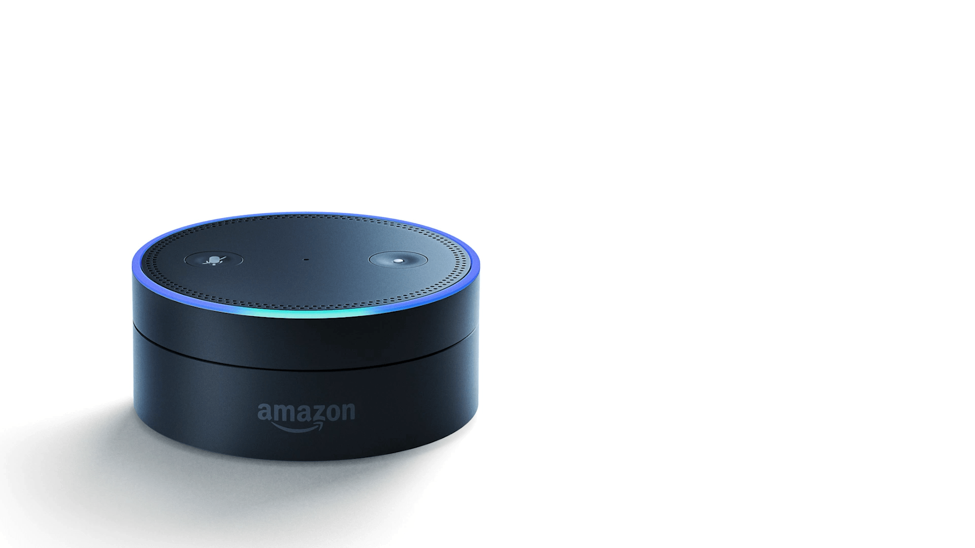
Keyword Spotting
Notes:
Or perhaps you’ve said Alexa.
Note: While these are all examples of TinyML, as they are implemented today -- they aren’t necessarily tiny
Recall what I said, tinyML is all about on-device intelligence on battery power devices like a coin-cell!
These devices are tethered into the wall, and rely on charging continuously.
So while they are indicative of tiny, they aren’t really tiny implementations.
--------
https://search.creativecommons.org/photos/461efedc-dfad-412c-b7be-6996b466f113 Edits to make GIF mine

Slide 6
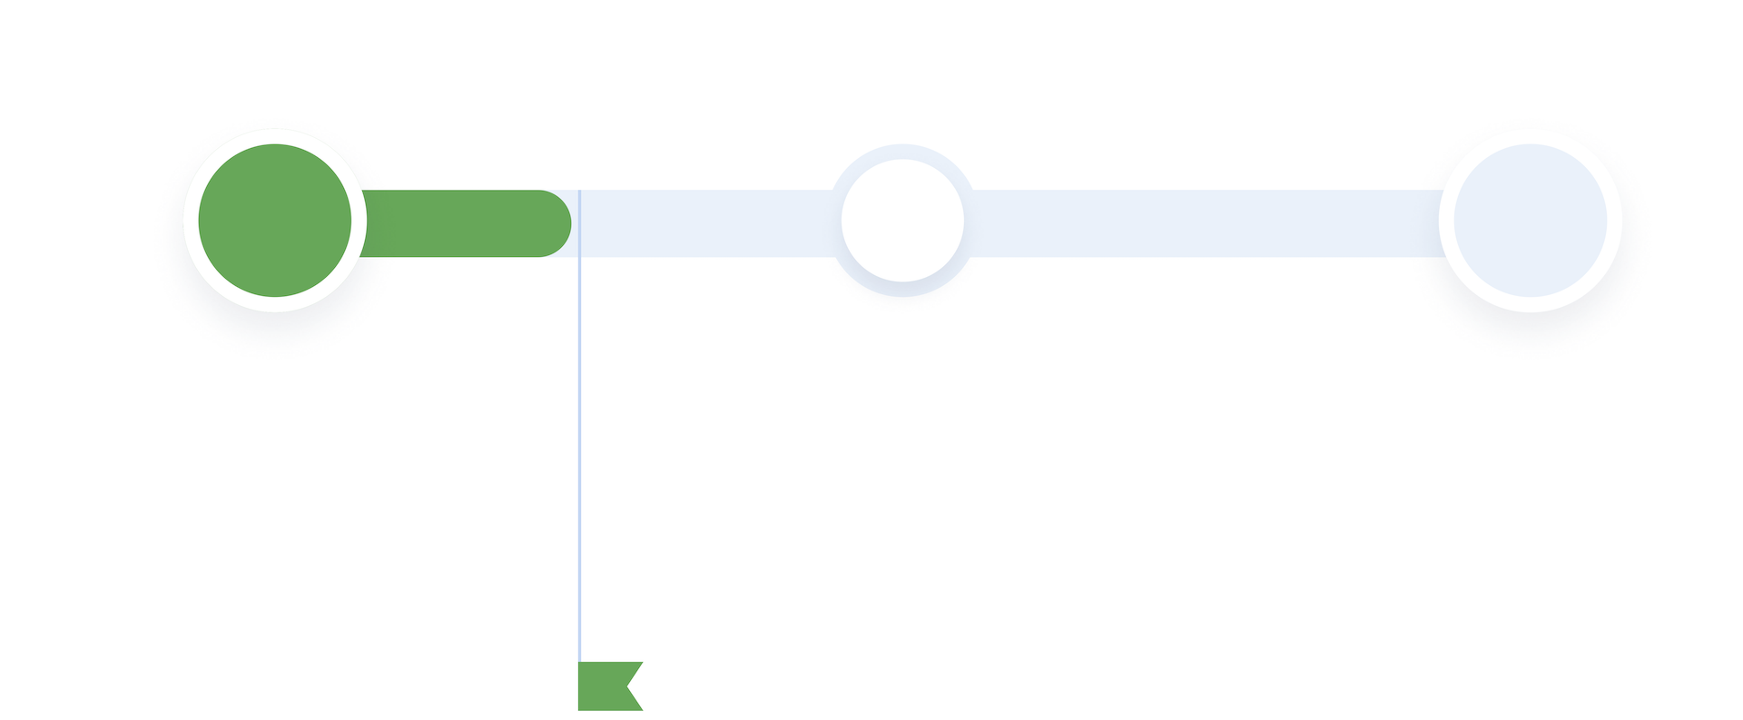



Step 1
Audio input
from microphone (sensor)
input
complete

Slide 7

Step 1
Audio input
from microphone (sensor)
input
complete

Slide 8

Step 1
Audio input
from microphone (sensor)
input
complete
Notes:
https://thenounproject.com/search/?q=audio&i=2634990

Slide 9
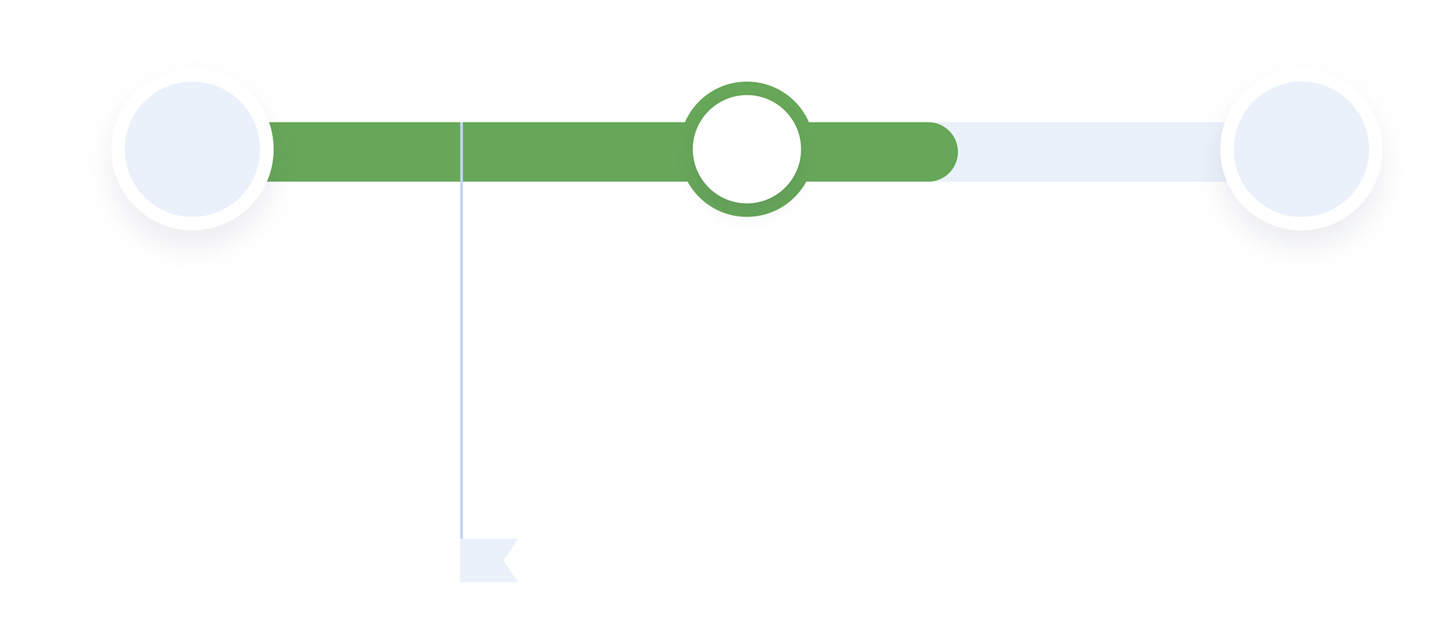

Step 2
Process input translation, then execute command
input
complete

Slide 10
Step 2
Process input translation, then execute command
input
complete

Slide 11
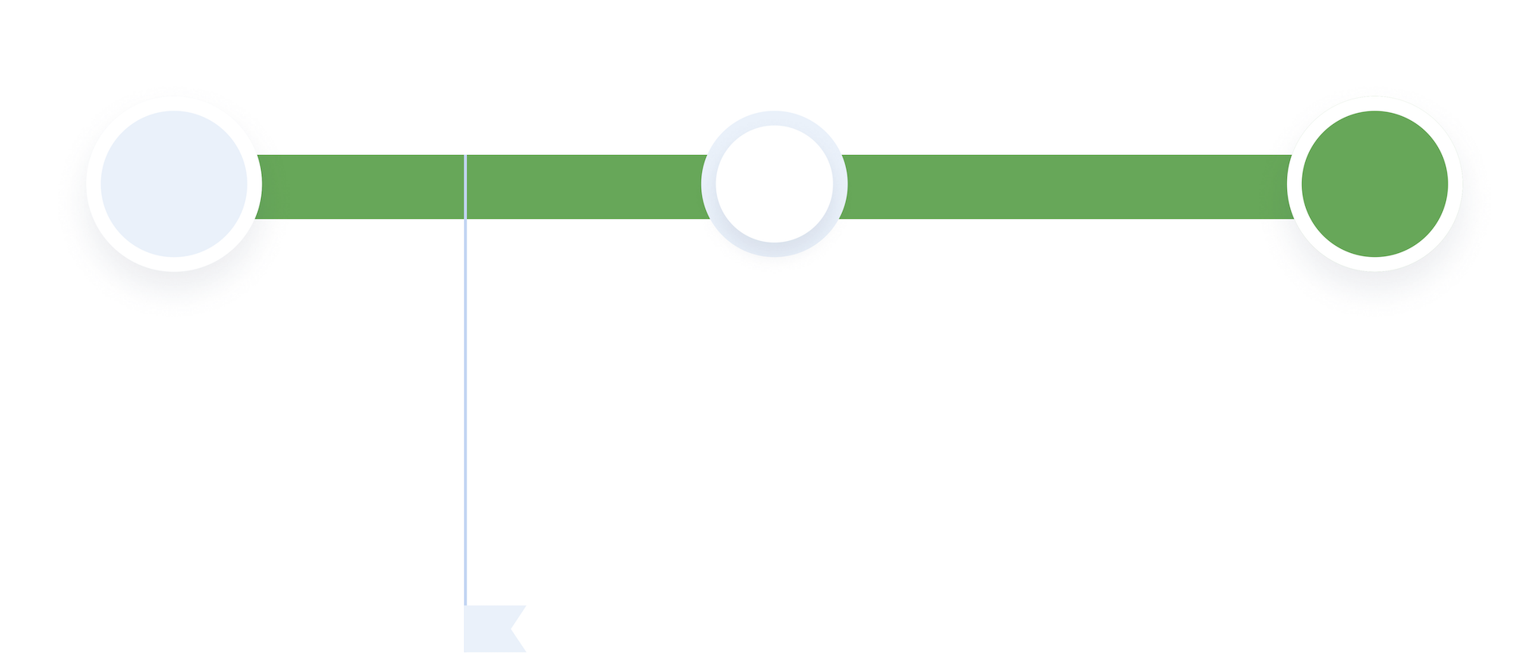
Step 1
Audio input from microphone (sensor)
Step 2
Process input translation, then execute command
Step 3
Generate Output
play response through embedded speaker
input
complete

Slide 12
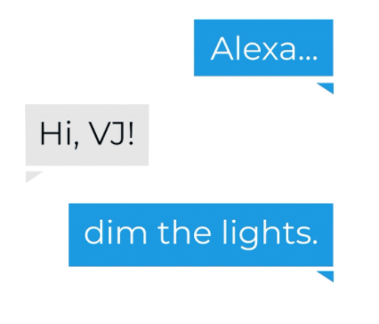

Step 1
Audio input from microphone (sensor)
Step 2
Process input translation, then execute command
Step 3
Generate Output
play response through embedded speaker
input
complete
Notes:
https://thenounproject.com/search/?q=dim+light&i=2394116

Slide 13
Notes:
https://thenounproject.com/search/?q=dim+light&i=2394116

Slide 14
Questions
How do we capture the data to feed into the neural network?

Slide 15
Questions
How do we capture the data to feed into the neural network?
How do you design the neural network to take in the speech signal?

Slide 16
Questions
How do we capture the data to feed into the neural network?
How do you design the neural network to take in the speech signal?
What dataset does the neural network need to be trained?

Slide 17
Questions
How do we capture the data to feed into the neural network?
How do you design the neural network to take in the speech signal?
What dataset does the neural network need to be trained?
How do we pre-process the data for neural network inference?

Slide 18
Questions
How do we capture the data to feed into the neural network?
How do you design the neural network to take in the speech signal?
What dataset does the neural network need to be trained?
How do we pre-process the data for neural network inference?
How do you post-process the neural network output?

Slide 19
Questions
How do we capture the data to feed into the neural network?
How do you design the neural network to take in the speech signal?
What dataset does the neural network need to be trained?
How do we pre-process the data for neural network inference?
How do you post-process the neural network output?
How do you make sure there is no bias in the dataset?

Slide 20
Questions
How do we capture the data to feed into the neural network?
How do you design the neural network to take in the speech signal?
What dataset does the neural network need to be trained?
How do we pre-process the data for neural network inference?
How do you post-process the neural network output?
How do you make sure there is no bias in the dataset?
How do you deploy this on the microcontroller?

Slide 21
TinyML Application Areas
Home
Office
Industry
Notes:
Home: https://thenounproject.com/search/?q=home&i=3482656
Office: https://thenounproject.com/search/?q=office&i=708890
Industry: https://thenounproject.com/search/?q=industry&i=3321404

Slide 22
Minimum
Image Sensors
Thermal, Image

Slide 23
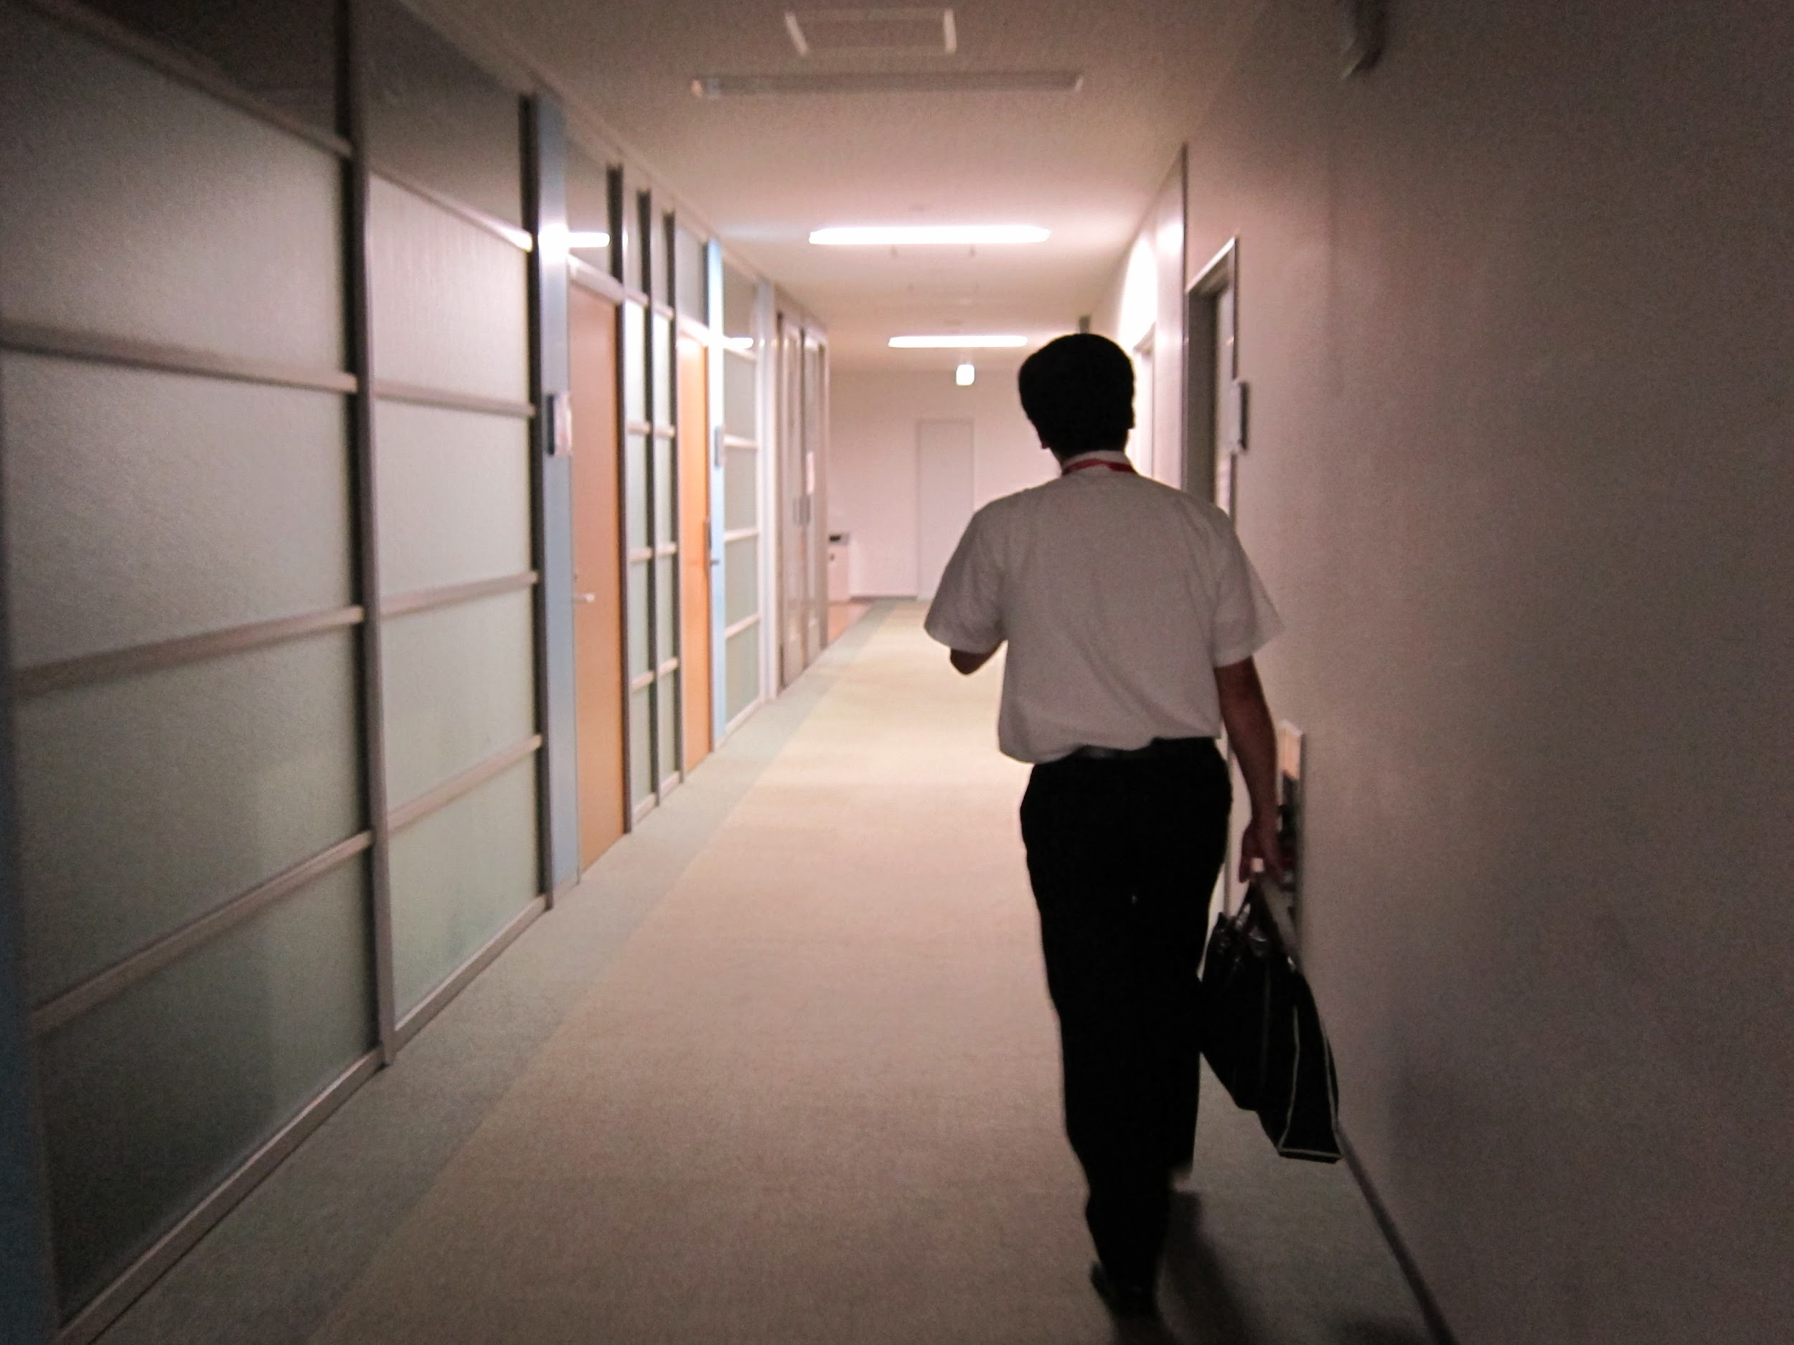
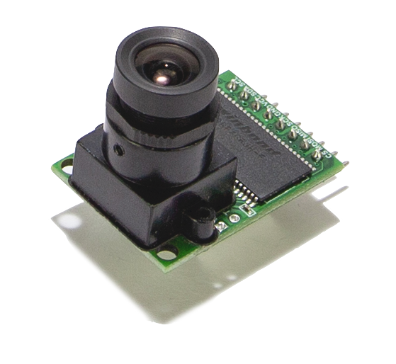
Notes:
https://search.creativecommons.org/photos/5d133195-bbc7-46b8-a18c-e2610b79bb4c
Camera from course kit image!! (Ours!)

Slide 24
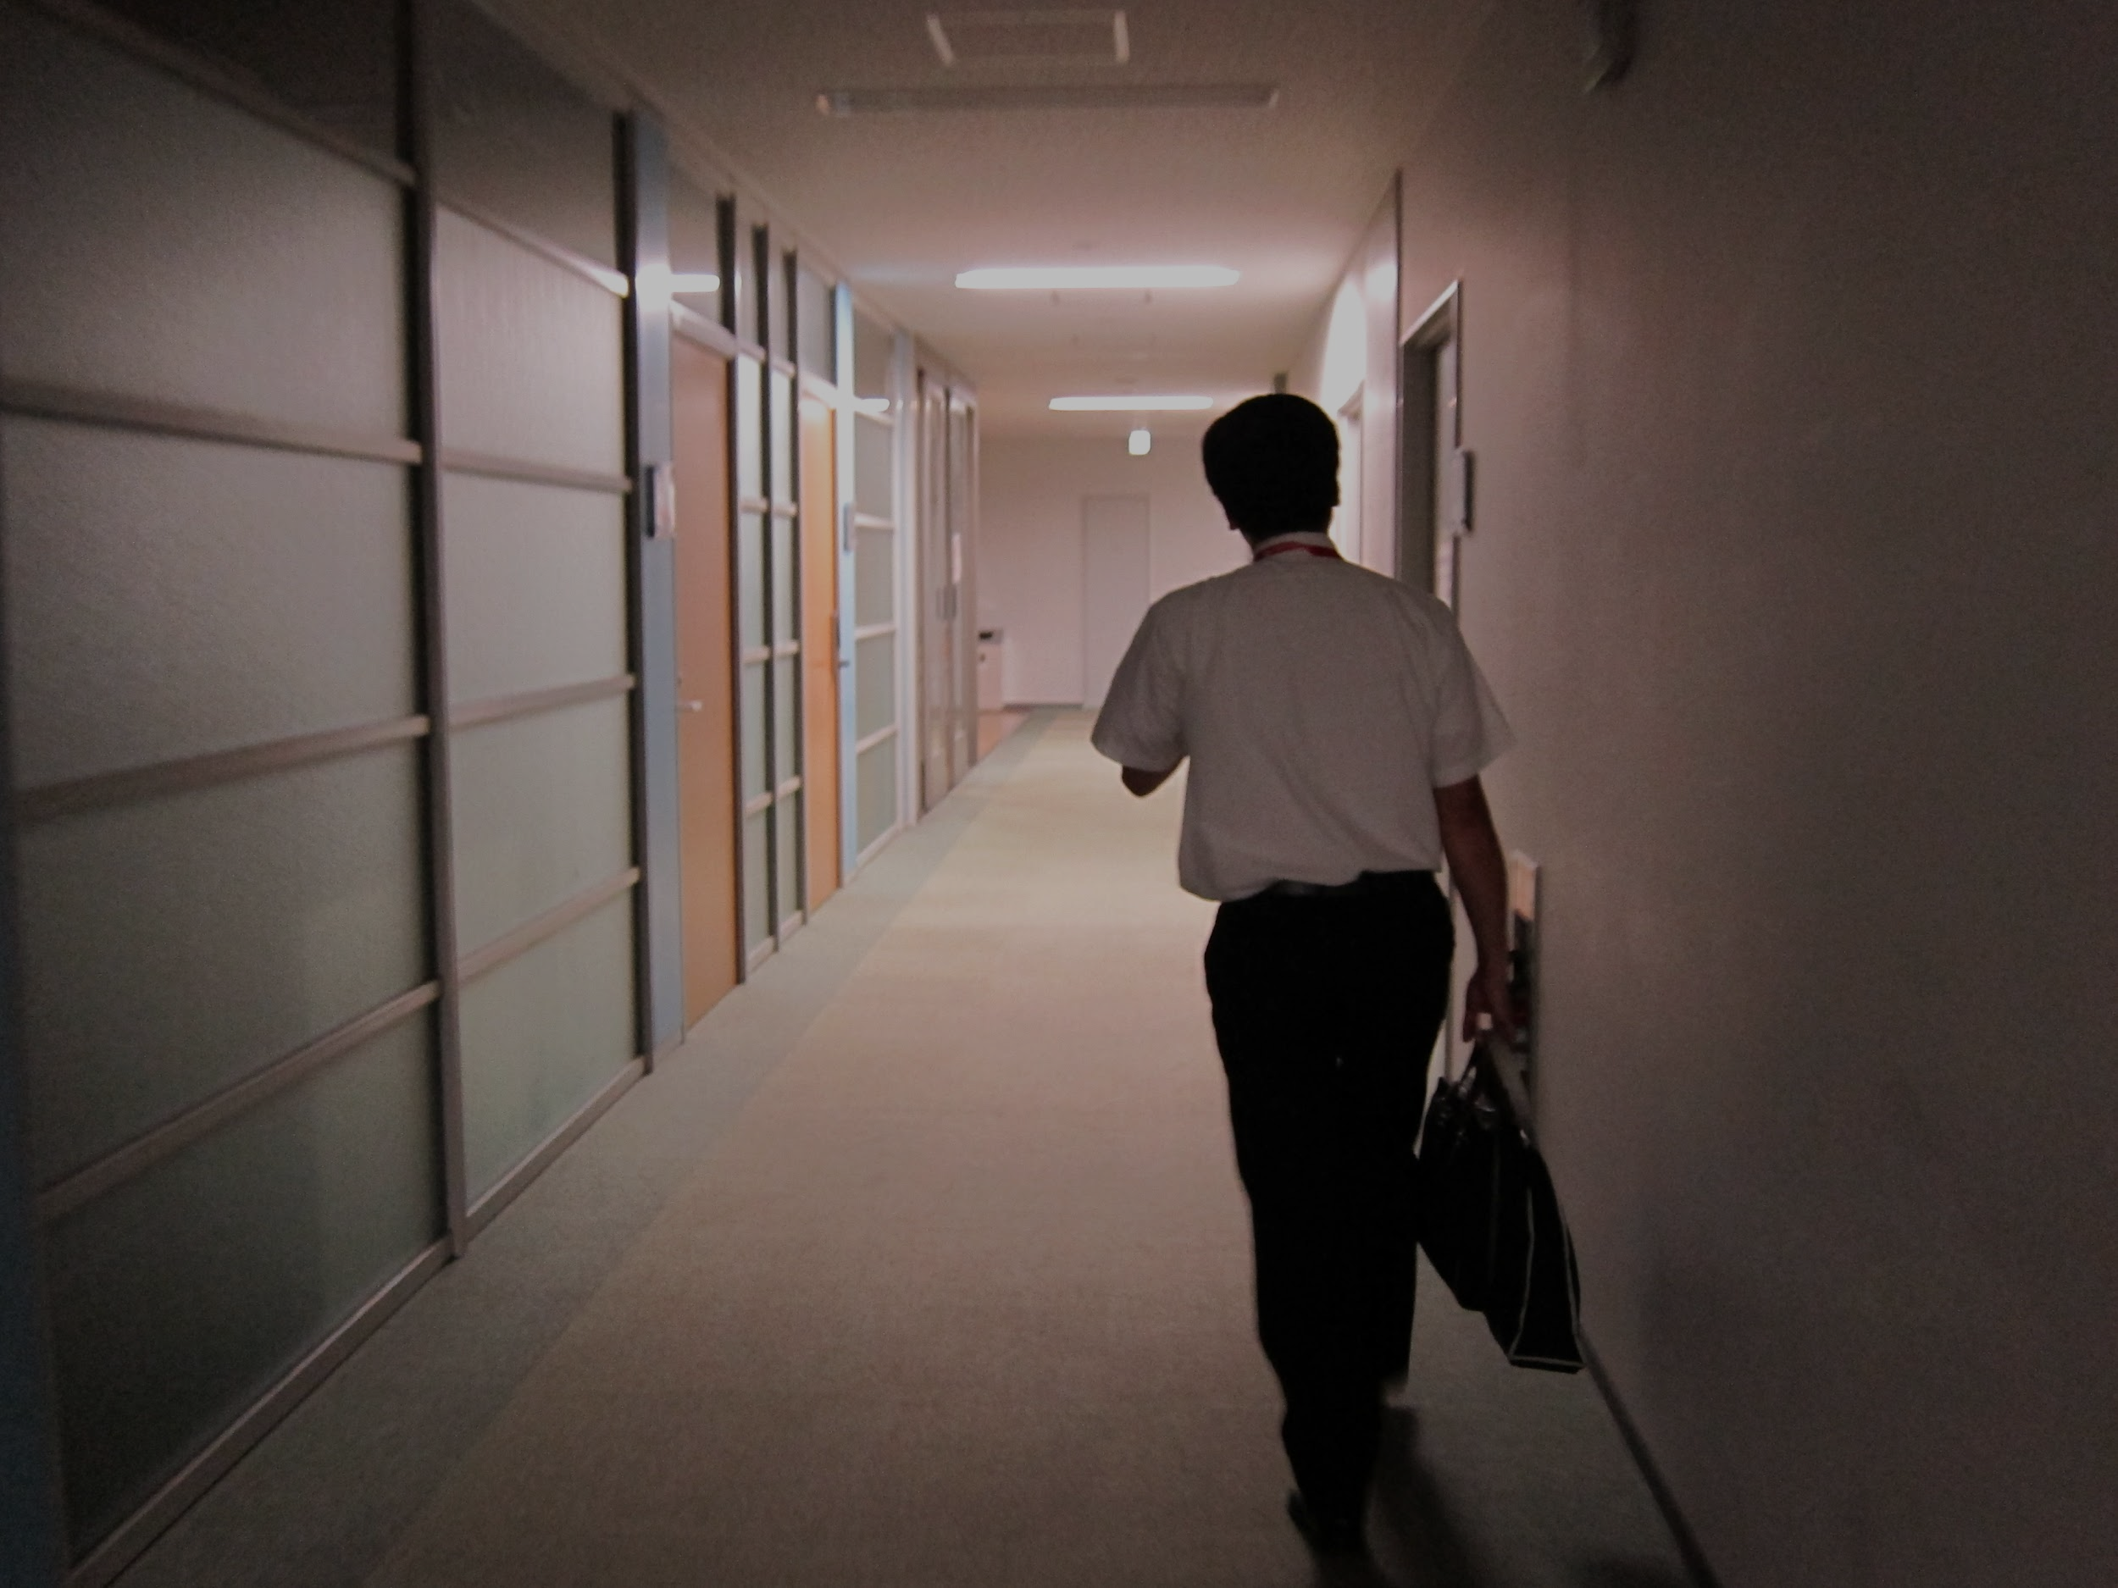
Notes:
https://search.creativecommons.org/photos/5d133195-bbc7-46b8-a18c-e2610b79bb4c

Slide 25
ML Model Evolution
MobileNet (2015)
MobileNetv1
70.6% accuracy
16.9MB in size
Source: S. Bianco, R. Cadene, L. Celona, and P. Napoletano, “Benchmark analysis of representative deep neural network architectures,” IEEE Access, vol. 6, pp. 64 270–64 277, 2018
Notes:
https://lib.dr.iastate.edu/cgi/viewcontent.cgi?article=8563&context=etd

Slide 26
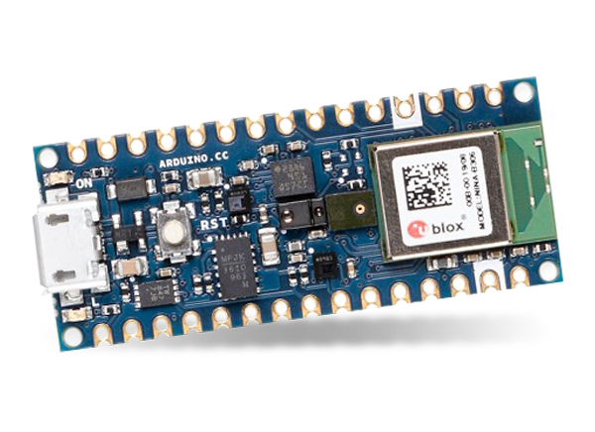
ML Model Evolution
Problem
Our board (in your kit for Course 3) only has 256KB of RAM (memory) yet MobileNetv1 needs 16.9MB!
MobileNet (2015)
MobileNetv1
70.6% accuracy
16.9MB in size
Source: S. Bianco, R. Cadene, L. Celona, and P. Napoletano, “Benchmark analysis of representative deep neural network architectures,” IEEE Access, vol. 6, pp. 64 270–64 277, 2018
Notes:
https://lib.dr.iastate.edu/cgi/viewcontent.cgi?article=8563&context=etd

Slide 27
How do we engineer a TinyML vision network?
Think:
Compute operations
Notes:
https://lib.dr.iastate.edu/cgi/viewcontent.cgi?article=8563&context=etd

Slide 28
How do we engineer a TinyML vision network?
Think:
Compute operations
Operator numerics
Notes:
https://lib.dr.iastate.edu/cgi/viewcontent.cgi?article=8563&context=etd

Slide 29
How do we engineer a TinyML vision network?
Think:
Compute operations
Operator numerics
Compression methods (e.g., pruning, quantization)
Notes:
https://lib.dr.iastate.edu/cgi/viewcontent.cgi?article=8563&context=etd

Slide 30
What is the end-to-end workflow?
Notes:
https://thenounproject.com/photo/rear-view-of-two-business-people-walking-through-office-corridor-0gzXjb/

Slide 31
Questions
How do we capture the data to feed into the neural network?
How do you design the neural network to take in the image?
What dataset does the neural network need to be trained?
How do we pre-process the data for neural network inference?
How do you post-process the neural network output?
How do you make sure there is no bias in the dataset?
How do you deploy this on the microcontroller?

Slide 32
Questions
How do we capture the data to feed into the neural network?
How do you design the neural network to take in the image?
What dataset does the neural network need to be trained?
How do we pre-process the data for neural network inference?
How do you post-process the neural network output?
How do you make sure there is no bias in the dataset?
How do you deploy this on the microcontroller?
How do we ensure that the neural network is resilient?

Slide 33
Questions
How do we capture the data to feed into the neural network?
How do you design the neural network to take in the image?
What dataset does the neural network need to be trained?
How do we pre-process the data for neural network inference?
How do you post-process the neural network output?
How do you make sure there is no bias in the dataset?
How do you deploy this on the microcontroller?
How do we ensure that the neural network is resilient?
How do we get the neural network to train faster?

Slide 34
TinyML Application Areas
Home
Office
Industry
Notes:
Home: https://thenounproject.com/search/?q=home&i=3482656
Office: https://thenounproject.com/search/?q=office&i=708890
Industry: https://thenounproject.com/search/?q=industry&i=3321404

Slide 35
Minimum
Motion Sensors
Gyroscope, Radar, Accelerometer
Notes:
https://commons.wikimedia.org/wiki/File:Autoencoder_schema.png

Slide 36
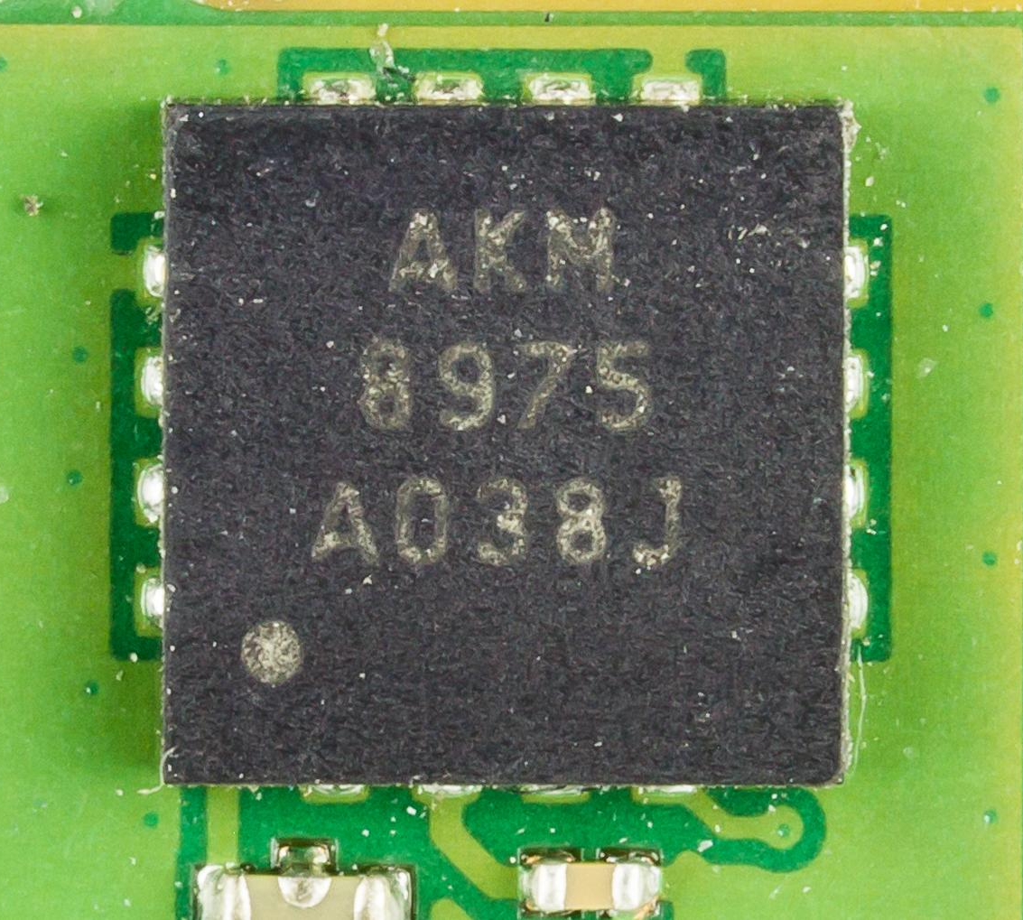
Minimum
Notes:
https://en.wikipedia.org/wiki/MEMS_magnetic_field_sensor#/media/File:Motorola_Xoom_-_AKM_Semiconductor_AKM8975-1693.jpg

Slide 37
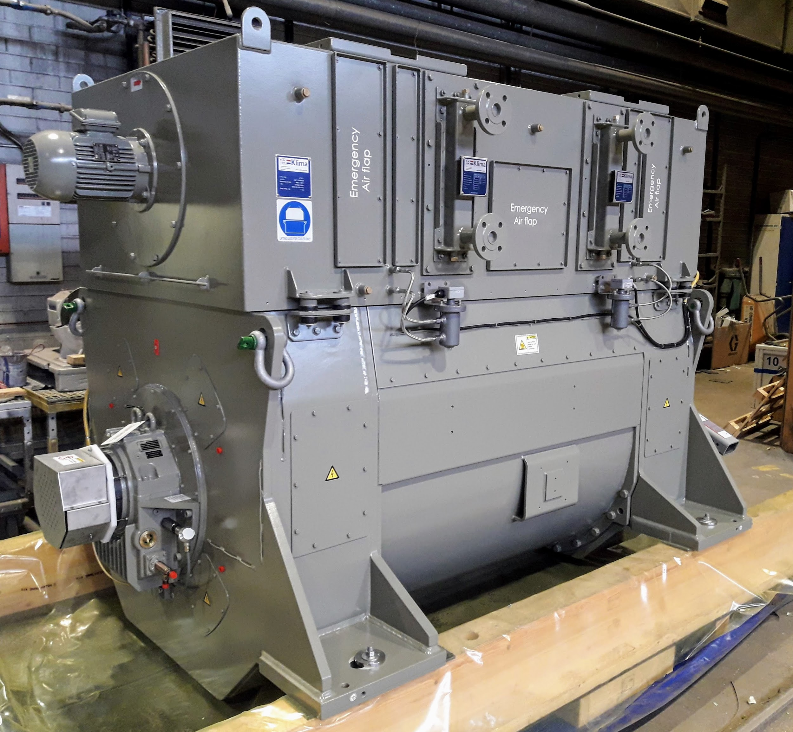
Minimum
Notes:
https://commons.wikimedia.org/wiki/File:Marine_generator.jpg

Slide 38
Minimum

Slide 39


?
Notes:
https://thenounproject.com/search/?q=yes+no&i=1896716
https://thenounproject.com/search/?q=x&i=2222123

Slide 40
?
Notes:
https://thenounproject.com/search/?q=yes+no&i=1896716
https://thenounproject.com/search/?q=x&i=2222123

Slide 41
?
Notes:
https://thenounproject.com/search/?q=yes+no&i=1896716
https://thenounproject.com/search/?q=x&i=2222123

Slide 42
?
?
Notes:
https://thenounproject.com/search/?q=yes+no&i=1896716
https://thenounproject.com/search/?q=x&i=2222123

Slide 43
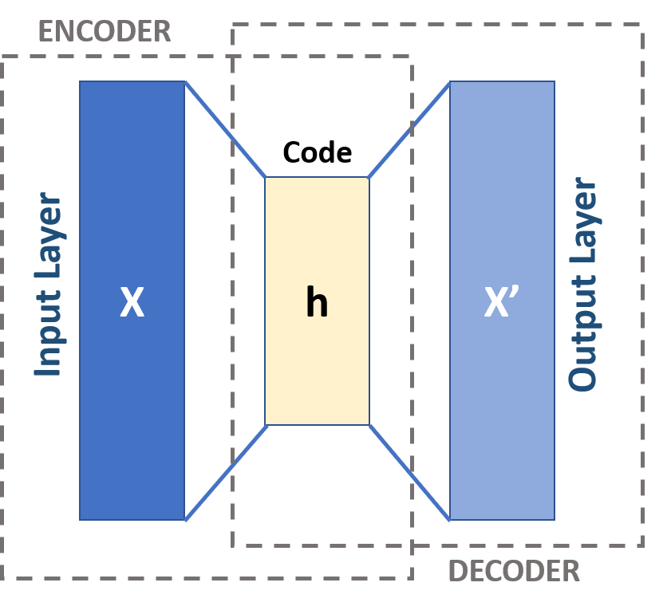
Autoencoder
?
Notes:
https://thenounproject.com/search/?q=yes+no&i=1896716
https://thenounproject.com/search/?q=x&i=2222123

Slide 44
Questions
?
How do we capture the time-series data to feed into the neural network?
How do we pre-process the data for neural network inference?
How do you design the autoencoder neural network?
What dataset does the neural network need to be trained?
How do you post-process the neural network output?
How do you make sure there is no bias in the dataset?
How do you deploy this on the microcontroller?

